Slide 1

Projet POST_IT
C - Dev & Go - MVVM frameworks

Slide 2
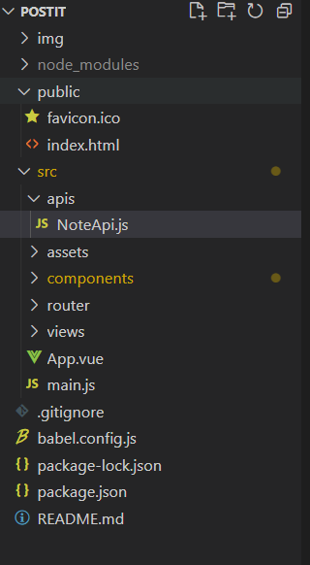
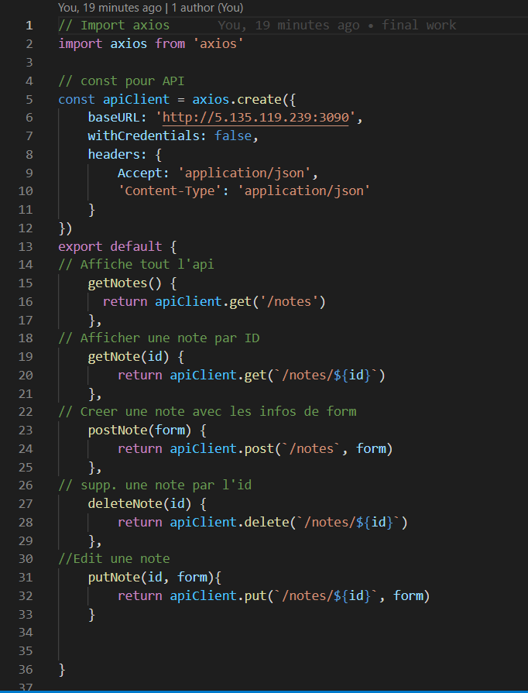


GOALS
Creating Vue.js component
Implementation of a model allowing interaction with data

Slide 3
PROCESS
Vue.js
Practice
Test
API
Link
Test
CSS
Bootstrap
Test

Slide 4
DIFFICULTIES & IMPROVEMENT
Difficulties
Link between data and views
Component life cycle
Responsiveness
Use a CSS Boostrtap
Improvement
Use of LocalStorage
Connect the differents methods
Vuex

